Slide 1
C#: Synchronous vs Asynchronous functions (How to use async and await keywords)
By Anele Ngwekazi

Slide 2
Agenda
Asynchronous vs Synchronous
What is Asynchronous and Synchronous processing
Disadvantages of Asynchronous and Synchronous programming
Benefits of Asynchronous and Synchronous programming
Asynchronous programming with async and await
Demo
Conclusion

Slide 3

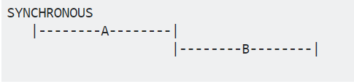
What is Asynchronous
What is Synchronous
Form of parallel processing
Use main or multiple Threads to complete an N Tasks
Form of serial processing
Uses only main thread to complete a task
Disadvantages of Asynchronous
Disadvantages of Synchronous
Not great in working with shared resources
Some processes can be slow and affect the entire system
Benefits of Asynchronous
Benefits of Synchronous
Allows a process to run separately from the main thread
Works perfectly with simple and short operation
Notes:
If any process is blocked in a synchronous application, all are blocked. Your application stops responding, and you might conclude that it has failed when instead it's just waiting.

Slide 4
Asynchronous programming with async and await
The method signature includes an async modifier.
The name of an async method, by convention, ends with an "Async" suffix.
C# 5 introduced a simplified approach, async programming, that leverages asynchronous support in the .NET Framework 4.5 and higher, .NET Core, and the Windows Runtime.
The compiler does the difficult work that the developer used to do, and your application retains a logical structure that resembles synchronous code.

Slide 5
Asynchronous programming with async and await (cont.)
The method signature includes an async modifier.
The name of an async method, by convention, ends with an "Async" suffix.
The method signature includes an async modifier
The name of an async method, by convention, ends with an "Async" suffix.
An async method can have the following return types:
Task
Task<TResult>
void

Slide 6
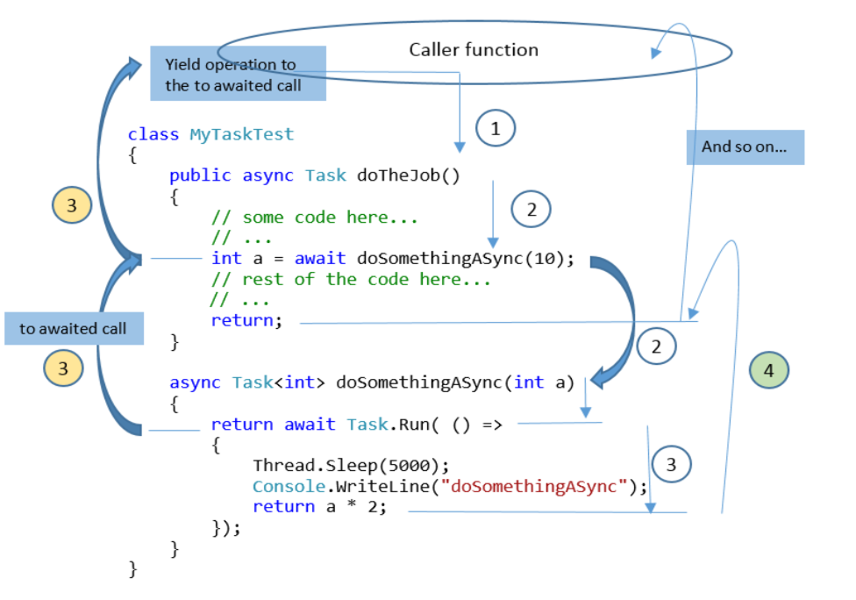
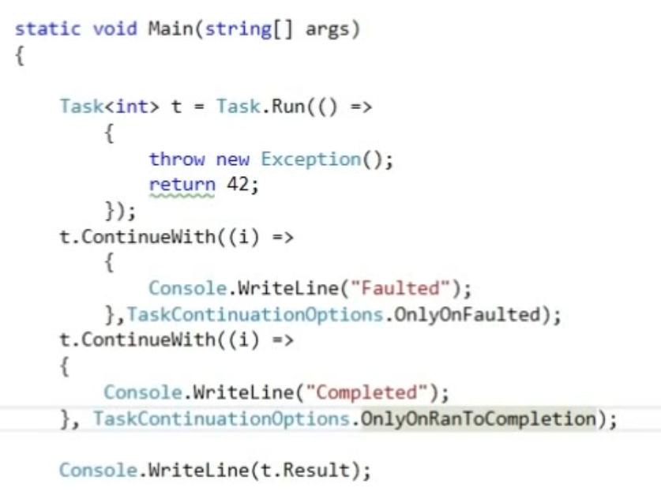
Demo

Slide 7
Conclusion
You can avoid performance bottlenecks and enhance the overall responsiveness of your application by using asynchronous programming
traditional techniques for writing asynchronous applications can be complicated, making them difficult to write, debug, and maintain.
When you use asynchronous methods, the application continues to respond to the UI. You can resize or minimize a window, for example, or you can close the application if you don't want to wait for it to finish.

